Slide 1
3D Graphics and Matrix Manipulation
Notes:
Hello and welcome.
In this video, we will <…complete the sentence that talks about the title…>.

Slide 2
Module Syllabus
3D Graphics
Matrices: Model, View, and Projection
Matrix Manipulation
Addition
Multiplication
Identity Matrix
Scaling
Rotation
Projection

Slide 3
3D Graphics
3D computer graphics are graphics that make use of the third dimension, conveying depth to display models, etc.
Earlier material showed how to create a 2D triangle using a vertex array, which defined the X and Y coordinates for each vertex. When defining a 3D object, a value for the Z axis must also be defined.
Creating 3D graphics is generally done in three stages:
Modelling
Animation
Rendering
Notes:
3D computer graphics are graphics that make use of the third dimension (conveying depth) to display models/geometric data. In the previous lab, we saw how to create a 2D triangle using a vertex array, which defined the X and Y coordinates for each vertex. When defining a 3D object, we also have to define a value for the Z axis.
The creation of 3D computer graphics can generally be separated into three main phases:
Modelling: creating a model based on the shape of an object
Animation: movement of objects within a scene
Rendering: generation of the final scene/graphic

Slide 4
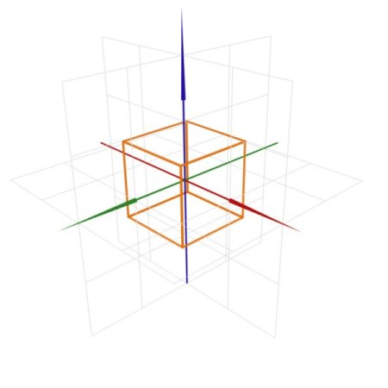
A 3D Object
Begin with a number of vertices that define the points of the object.
These defined points are within an XYZ coordinate space.
The points are linked into a collection of primitives, commonly triangles, that represent the shape.
Notes:
We begin with a number of vertices that define the points of the object. These defined points are within an XYZ coordinate space.
The points are linked into a collection of primitives, commonly triangles, that represent the shape.

Slide 5
Cube: Vertex Array
GLfloat cubeVertices[] = {-1.0f, 1.0f, -1.0f, /* Back. */
1.0f, 1.0f, -1.0f,
-1.0f, -1.0f, -1.0f,
1.0f, -1.0f, -1.0f,
-1.0f, 1.0f, 1.0f, /* Front. */
1.0f, 1.0f, 1.0f,
-1.0f, -1.0f, 1.0f,
1.0f, -1.0f, 1.0f,
-1.0f, 1.0f, -1.0f, /* Left. */
-1.0f, -1.0f, -1.0f,
-1.0f, -1.0f, 1.0f,
-1.0f, 1.0f, 1.0f,
1.0f, 1.0f, -1.0f, /* Right. */
1.0f, -1.0f, -1.0f,
1.0f, -1.0f, 1.0f,
1.0f, 1.0f, 1.0f,
-1.0f, -1.0f, -1.0f, /* Top. */
-1.0f, -1.0f, 1.0f,
1.0f, -1.0f, 1.0f,
1.0f, -1.0f, -1.0f,
-1.0f, 1.0f, -1.0f, /* Bottom. */
-1.0f, 1.0f, 1.0f,
1.0f, 1.0f, 1.0f,
1.0f, 1.0f, -1.0f
};
This code defines the vertex array for a cube.
What is the difference between this and the triangle vertex array?
The former is much larger, because four vertices must be defined for each face of the cube, as well as an extra Z coordinate per vertex.
Notes:
This is the code that defines our vertex array, which will be used to draw our cube. As we can see, there is a big difference between this cube vertex array and the triangle vertex array. First of all, it is much larger, this is because we have to define four vertices for each face of the cube, and also define an extra Z coordinate per vertex.
Looking at the comments in the code we can see how each face is divided in the array.

Slide 6
3D Objects: Transformations
A number of transformations can be performed to make objects move, rotate etc.
This is done via matrix manipulation.
Notes:
Now that we are able to define objects in 3D space and not be restricted by 2D boundaries, we can perform a number of transformations to make our objects move, rotate etc.
This is done via matrix manipulation. We will touch on the basics of these transformations and then look at how they are replicated in matrix manipulation.

Slide 7

What is a Matrix?
A matrix is an array of numbers typically displayed in the form of a rectangle or square.
1
2
3
4
5
6
7
8
10
11
12
13
The example above is of a 3x4 matrix, consisting of three rows and four columns.
Each number in the matrix is called an element.
Notes:
Matrices are commonly used in mathematics. A matrix is an array of numbers or symbols that are displayed in the form of a rectangle or square.
In this example, we see a 3x4 matrix that consists of three rows and four columns. Each number in the matrix is an element.
Note: There is no convention that the elements have to be ordered in increasing size, as shown in this example. The numbers could be completely reshuffled if the creator of the matrix desires.

Slide 8
Types of Matrices
In graphics development, there are three main matrices per application:
Model matrix
View matrix
Projection matrix
Notes:
In graphics development, there are three matrices that are commonly used in every application that displays graphics. We will briefly look at each of these as you will need to understand them for the lab.

Slide 9
Model Matrix
States where the object should be drawn on the screen
Useful for when drawing more than one object
Common tasks performed on the model matrix
Movement
Scaling
Rotation
Notes:
Of the three main types of matrices, the model matrix is the most heavily used. This is because it shows where objects should be drawn on the scene. This is important when dealing with more than one object, so that they do not overlap if we wish the viewer see both.
A number of transformations are typically performed on this matrix, in order to determine the position, size and rotation of the object/model. These include translation, scaling and rotation.

Slide 10
View Matrix
The view matrix handles any movement of the camera.
This alters how the scene is viewed.
For example, in a scene with buildings, the user doesn’t want to have to move them all, so instead moves the camera (view matrix) to show what is wanted.

Slide 11
The Projection Matrix
The projection matrix handles the depth of the scene.
Objects that are closer to the camera are made to look bigger, and objects further away are made to look smaller.

Slide 12
Identity Matrix
An identity matrix (In) is an n x n matrix, with a diagonal line of 1s from the top left to the bottom right, and with all other elements set as 0:
1
0
0
I₃
=
0
1
0
0
0
1
Multiplying any matrix by the identity matrix, will provide a result of the same matrix that the identity matrix is multiplied by. This assumes that it abides by the rule that the matrix has the same number of columns in A relative to rows in B.
Notes:
The identity matrix is commonly used in the mathematical side of matrix manipulation.
An identity matrix is an n x n matrix that consists of a diagonal line of 1s from the top left element, to the bottom right. Each of the remaining elements is set to 0. The matrix is denoted (I_{n}).
Multiplying a matrix by the identity matrix will result in the same matrix that you are multiplying it by – assuming the rules of equal number of columns in A to rows in B is followed.
It essentially acts as a multiply by 1.

Slide 13
Matrix Addition
Matrix addition is very simple; simply add the corresponding elements to obtain the result element in the final matrix.
4
8
3
2
+
5
1
6
1
4+3
8+2
7
10
=
5+6
1+1
11
2
Notes:
Now that we know what a matrix is, and have looked at some of the most commonly used matrices, we can examine how to manipulate them.
Addition is a very simple calculation that we can do with matrices.
To find the resulting element in the final matrix, we simply add the corresponding elements from the matrices being added together.
So for element 1, we simply add element 1 of both matrices together, and so on, as shown in this example.

Slide 14
Matrix Multiplication
Multiply the elements of a row in A with the corresponding column in B and add up the results.
The number of columns in the first matrix must equal the number of rows in the second matrix.
An example of matrix multiplication is shown on the next slide.

Slide 15

Matrix Multiplication
3
4
1
7
1
9
1
7
3
2
3
4
5
6
2
5
1
6
3 * 7 + 4 * 2 + 1 * 5
3 * 1 + 4 * 3 + 1 * 1
3 * 9 + 4 * 4 + 1 * 6
34
16
49
1 * 7 + 7 * 2 + 3 * 5
1 * 1 + 7 * 3 + 3 * 1
1 * 9 + 7 * 4 + 3 * 6
=
36
25
55
57
25
81
5 * 7 + 6 * 2 + 2 * 5
5 * 1 + 6 * 3 + 2 * 1
5 * 9 + 6 * 4 + 2 * 6

Slide 16
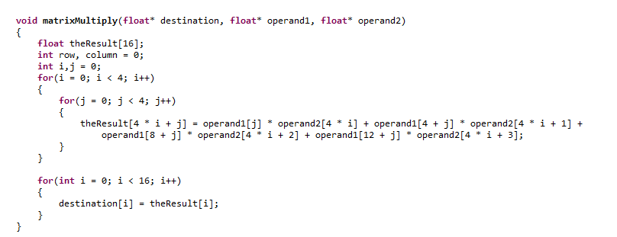
Multiplication: Code Example

Slide 17
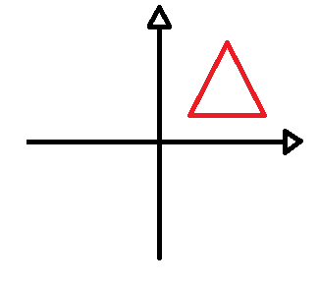
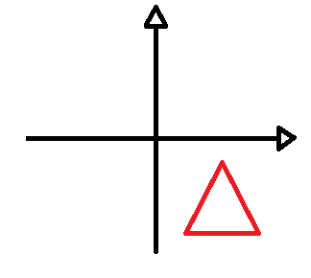
Translation
Translation is the process of moving an object in the X, Y, or Z axis.
2D example of translation
Notes:
Translation is the process of moving an object in the X,Y, or Z axis; effectively, moving each vertex of the shape a set amount in order to move the shape as a whole.
We can see a simple 2D example of this here.

Slide 18
Translation
1
0
0
x
0
1
0
y
0
0
1
z
0
0
0
1
The elements labelled x, y and z are the ones to alter in order to translate an object.
x to alter the X axis, y for the Y axis, and z for the Z axis
Notes:
Let’s look at how we can achieve this effect using matrix manipulation.
As we can see in the example matrix above, there are some elements labelled x, y, and z. These are there elements we will alter in order to translate an object.
x to alter the X axis, y for the Y axis, and z for the Z axis
Note that in order for the math to work correctly, the final element in this column must be 1.

Slide 19
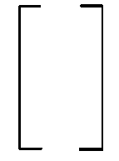
Translation
Translate a vector b by a vector a:
The vector to
translate an object by
1
0
0
ax
bx
Bx + ax
0
1
0
ay
by
By + ay
=
0
0
1
az
bz
Bz + az
0
0
0
1
1
1
Translation matrix
Vector b
(coordinates of object)
Resulting vector
after translation
The result is the original vector plus the values to translate the object by.
Notes:
We can multiply a vector b, containing the coordinates of an object, by a translation matrix containing a vector a, which is the vector we wish to translate the object by.
In the example above, we can see that the translation matrix has the vector in the final column. This matrix is then multiplied by the vector containing the coordinates. The result is the object coordinates, plus the values we wish to translate the object by, therefor translating the original coordinates.

Slide 20
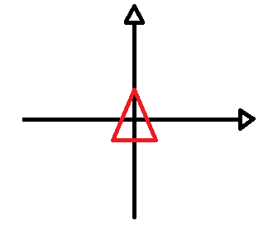
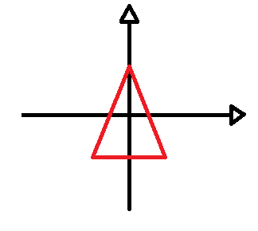
Scaling
Scaling is the process of enlarging or shrinking an object in some or all of the X, Y, and Z axes.
Example of 2D scaling

Slide 21
Scaling
Scaling is applied to a matrix in a similar way to translation.
To scale a vector b by a vector a
The vector to
scale an object by
ax
0
0
0
bx
Bx * ax
0
ay
0
0
by
=
By * ay
0
0
az
0
bz
Bz * az
0
0
0
1
1
1
Scaling matrix
Vector b
(coordinates of object)
Resulting vector
after scaling
The result is the original vector, multiplied by the scaling vector.
Notes:
The process for carrying out scaling using matrix manipulation is quite similar to that of translation.
We can multiply a vector b that contains the object coordinates by a scaling matrix that contains a vector a, which is the vector we wish to scale the object by.
In the example above, we can see that the scaling matrix contains vector a and is multiplied by the coordinate vector b. This results in the final vector multiplying the original coordinates by the scaling vector.

Slide 22
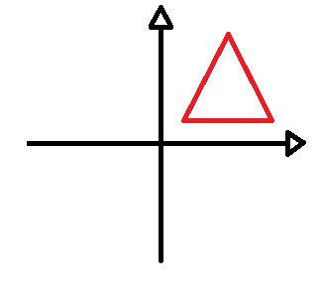
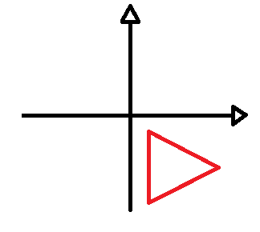
Rotation
Rotation is the act of rotating an object around an axis or point.
2D example of rotation around the point 0,0
Notes:
Rotation is the act of rotating an object around an axis or point.
In the example above, we can see a triangle being rotated around the point 0,0 on a graph.

Slide 23
Rotation
Performing rotation using matrices is a bit more complex than translation and scaling.
To rotate a shape by an angle θ requires three matrices to complete the rotation for the X, Y, or Z axis.
1
0
0
0
cosθ
0
0
cosθ
0
0
sinθ
-sinθ
0
cosθ
0
0
1
0
0
0
0
-sinθ
sinθ
cosθ
0
0
0
0
0
0
1
0
sinθ
cosθ
-sinθ
cosθ
0
0
0
1
0
0
0
1
0
0
0
1
Rotation in the X axis
Rotation in the Y axis
Rotation in the Z axis
Notes:
Performing rotation using matrices is a bit more complex than translation and scaling.
If we wish to rotate a shape by an angle θ, we have three matrices to complete the rotation for the X, Y, or Z axis.
We can see the examples of rotation in the three axes.

Slide 24
Rotation
An example is a Z rotation of 270º on a vector
0
1
0
1
0
cos(270)
-sin(270)
0
=
-1
0
0
0
=
-1
sin(270)
cos(270)
0
0
0
1
0
0
1
0
0
Original position is 1 in the X direction, but rotate 270 degrees anti-clockwise and reach -1 in the Y axis
Notes:
In this example, we perform rotation in the Z axis of 270º on a vector b.
We start by calculating the cos, -sin, and sin values of the degree we wish to rotate by – specific to the relevant Z rotation matrix.
We then multiply the original vector by the result and get an outcome.
In this case, we start with 1 in the X direction and have rotated to be -1 in the Y direction anticlockwise - 270º.

Slide 25


